Slide 1
Creating a Culture of Leadership
& PEOPLE that Support(s) Generational Diversity
"Avoiding Insufficient FUN-ds"
Martha J. Sales, Ed.D.
Dean of Students & Vice President of Student Experience
Western Kentucky University
BLESS 1 Consulting
Marthajsalesdr@gmail.com

Slide 2
Tell me WHO you SEE?
Financial management is the strategic planning, organizing, directing, and controlling of an organization's financial resources to achieve goals, maximize value, and ensure long-term sustainability. It involves managing cash flow, making investment decisions, and optimizing capital structure (debt/equity) to balance profitability with financial risk.

Slide 3
What is Generational Diversity in the WORKPLACE?
The term 'generational diversity' refers to the presence of different age groups within a population, community, or in the WORKPLACE —each with their own characteristics, experiences, perspectives and values—.
Generational diversity refers to having a vast range of ages represented in the workplace. Sometimes, the concept measures workforce ages on a broad scale.

Slide 4
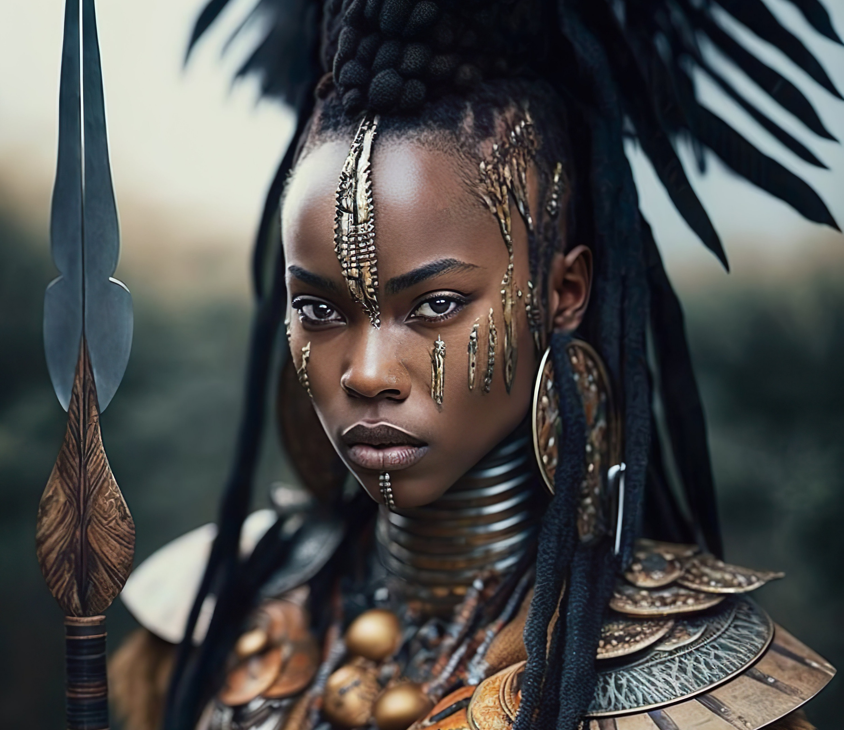
LEADERSHIP SUCKS!........
IF YOU DO IT RIGHT!

Slide 5
WHO IS IN THE HOUSE TODAY????
The Silent Generation (1928–1945): Currently 81–98 years old. Born during the Great Depression and World War II.
Baby Boomers (1946–1964): Currently 62–80 years old. A large, influential generation born post-WWII.
Generation X (1965–1980): Currently 46–61 years old. Often called the "middle child" generation, known for being self-reliant.
Millennials/Gen Y (1981–1996): Currently 30–45 years old. The first generation to come of age with the internet, experiencing both pre- and post-digital life.
Generation Z (1997–2012): Currently 14–29 years old. Known as digital natives, they are diverse, pragmatic, and highly tech-savvy.
Generation Alpha (2012–2024): Children and young teenagers, often the children of Millennials, defined by pervasive technology.
GEN Beta---(2025-2039)

Slide 6
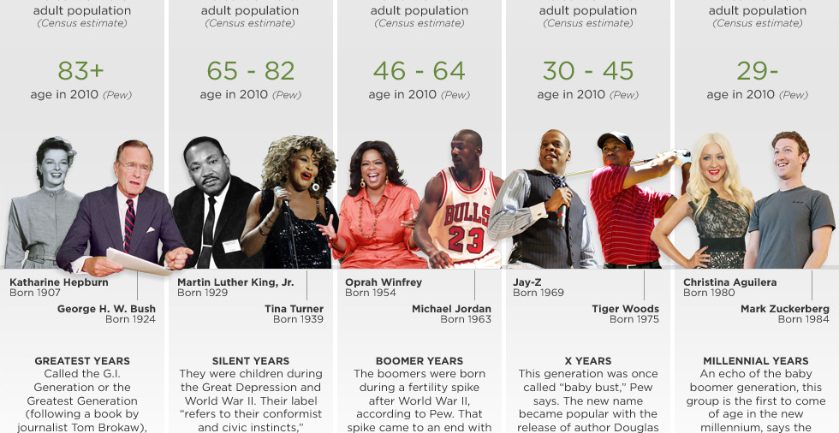

Slide 7
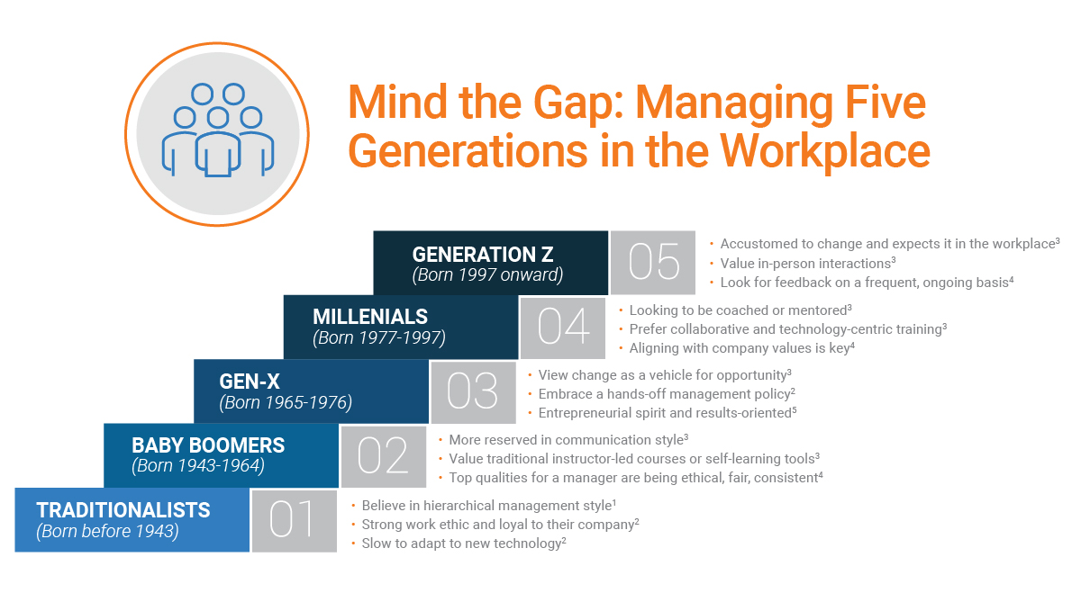

Slide 8
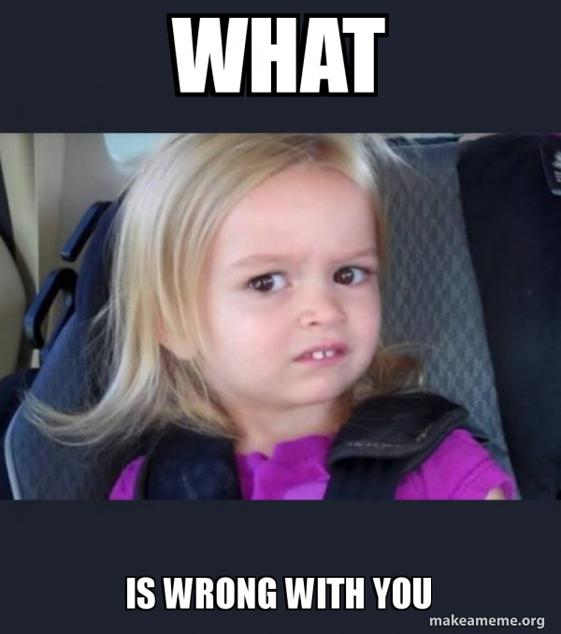

Slide 9

Can
STOP
The
"Overdraft"-with the right Connection!

Slide 10
MANAGING MULTIPLE GENERATIONS IN TODAY’S ENVIRONMENT
WORLD EVENTS DURING FORMATIVE YEARS
VIEWS TOWARD AUTHORITY
WHO SHOULD LEAD
VIEWS TOWARD WORK ETHIC
MOTIVATING MESSAGE
COMMUNICATION PREFERENCES

Slide 11
How to LEAD PEOPLE-older, younger and WILDLY Different than YOU!!!!
What They Value How They Like to Work How They Prefer to Connect What They Appreciate How They Want Feeback What Motivate Them to Stay What Breaks Their Trust How to Support Them Best

Slide 12
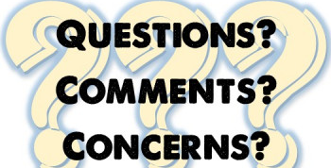

Slide 13
Additional Resources Stillman, D., & Stillman, J. (2017). Gen Z @ work: How the next generation is transforming. New York, NY: HarperCollins Publishers.
Talmon, G. A., & Beck-Dallahan, G., Eds. (2017). Mind the gap: Generational differences in medical education. Syracuse, NY: Gegensatz Press.
Generational Differences Chart retrieved from http://www.wmfc.org/uploads/GenerationalDifferencesChart.pdf https://www.bscai.org/Contractor-Connections-Hub/BSCAI-News/managing-five-generations-in-the-workplace
References

